Slide 1
CS X283: Wireless Networking
Dr. Uttam Ghosh
Computer Science
Vanderbilt University

Slide 2
Topics to be Discussed
Wireless LAN: IEEE 802.11
  Architecture
  Layers
  Framing
  Hidden Terminal and Expose Terminal Problems
  4-Way Handshaking Protocol
  CSMA/CA
  Addressing Mechanism
Mobile ad hoc networks (MANETs)
Wireless LANs Testbed
U. Ghosh

Slide 3
IEEE 802.11

Slide 4
WiFi
Almost all wireless LANs are based on IEEE 802.11.
IEEE 802.11 is know as WiFi=“Wireless Fidelity”.
Fidelity=Compatibility of wireless devices from different manufacturers.
WiFi Alliance is a non-profitable organization that does compatible testing (WiFi.org).
U. Ghosh

Slide 5
IEEE 802.11
IEEE has defined the specifications for a wireless LAN, called IEEE 802.11, which covers the physical and data link layers.
A BSS without an AP is called an ad hoc network;
a BSS with an AP is called an infrastructure network.
U. Ghosh

Slide 6
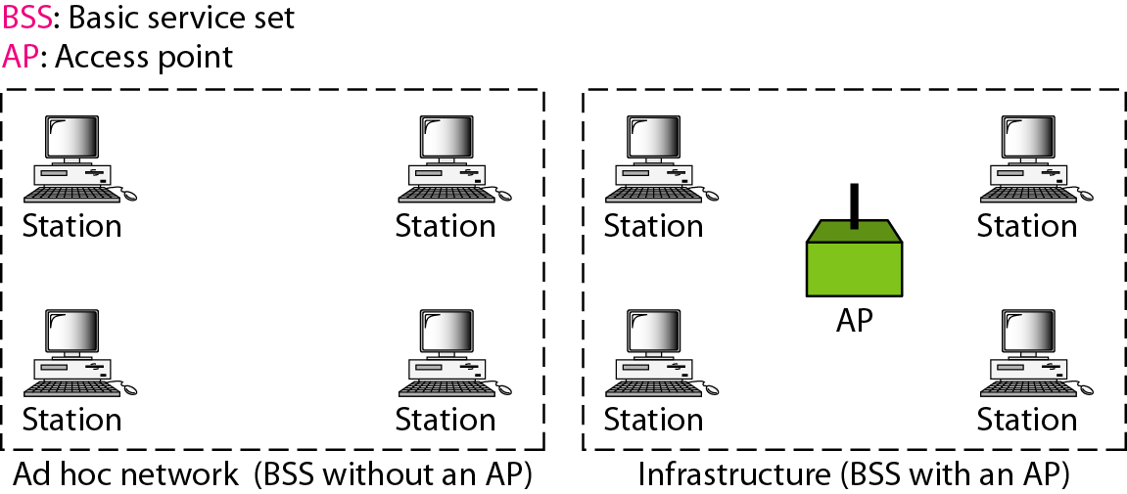
Figure 1 Basic service sets (BSSs)
U. Ghosh

Slide 7
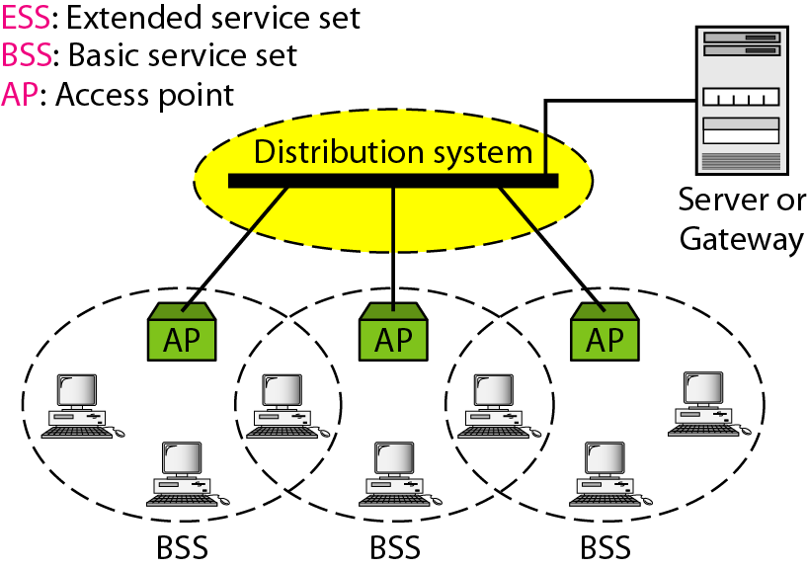
Figure 2 Extended service sets (ESSs)
U. Ghosh

Slide 8
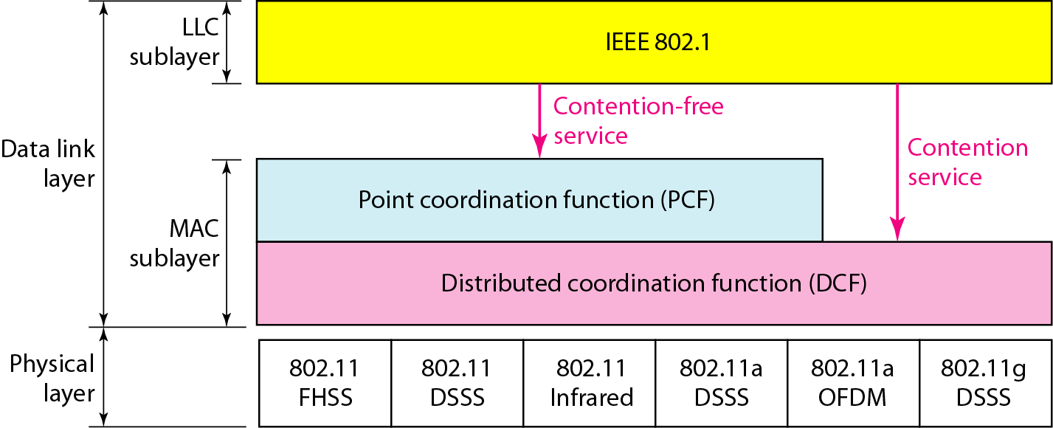
Figure 3 MAC layers in IEEE 802.11 standard
U. Ghosh

Slide 9
Physical Layer
802.11: 2.4 GHz, 1-2 Mbps
802.11b: 2.4 GHz, 11 Mbps nominal
Direct sequence spread spectrum (DSSS) in physical layer
802.11a: 5.8 GHz band, 54 Mbps nominal
802.11g: 2.4 GHz band, 54 Mbps nominal
802.11n: 2.4 or 5.8 GHz, Multiple antennae, up to 200 Mbps
These are different PHY layers. All have the same MAC layer.
All use CSMA/CA for multiple access
All have base-station and ad-hoc network versions
Power management allows a node to doze off
U. Ghosh

Slide 10
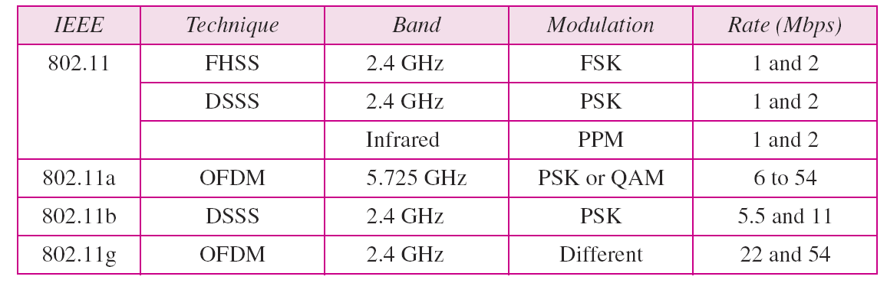
Table 1 Physical layers
U. Ghosh

Slide 11
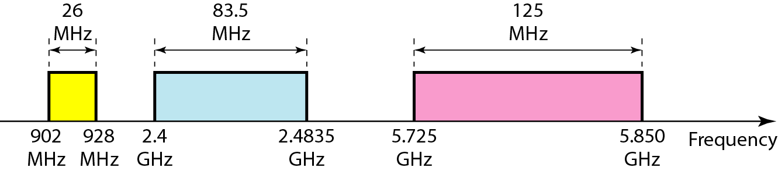
Figure 4 Industrial, scientific, and medical (ISM) band
U. Ghosh

Slide 12

Figure 5 CSMA/CA flowchart
U. Ghosh

Slide 13
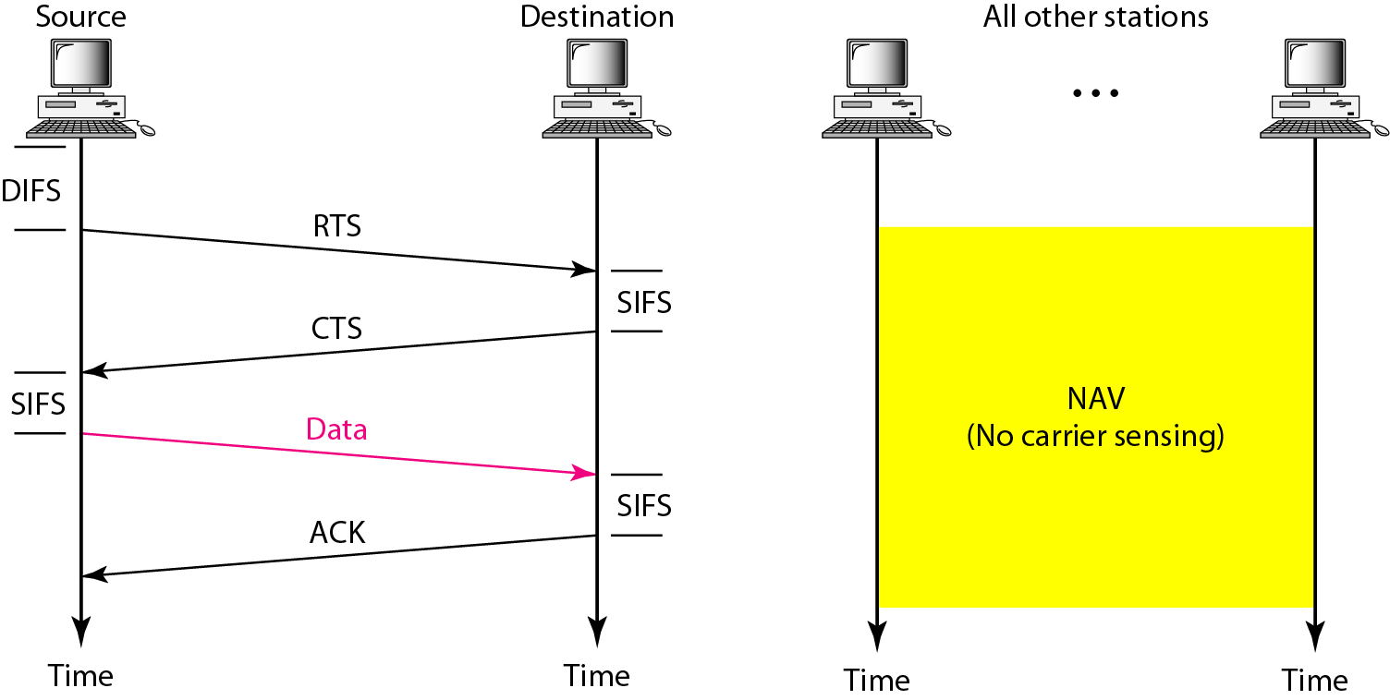
Figure 6 CSMA/CA and NAV
U. Ghosh

Slide 14

Figure 7 Frame format

Slide 15
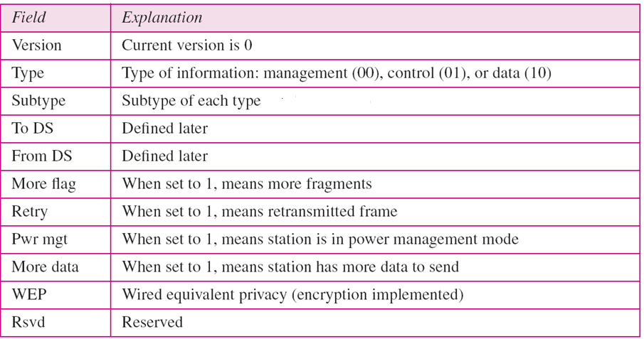
Table 2 Subfields in FC field
U. Ghosh

Slide 16
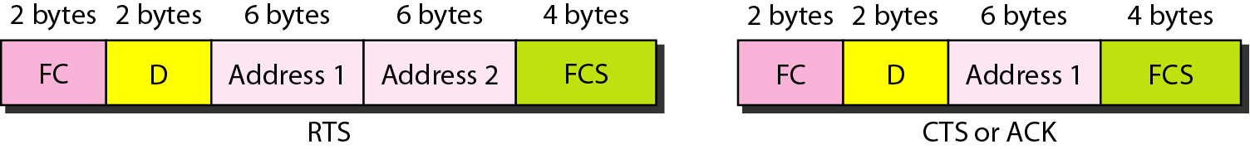
Figure 8 Control frames
U. Ghosh

Slide 17
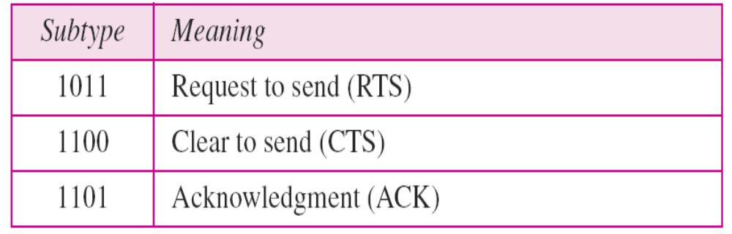
Table 3 Values of subfields in control frames
U. Ghosh

Slide 18
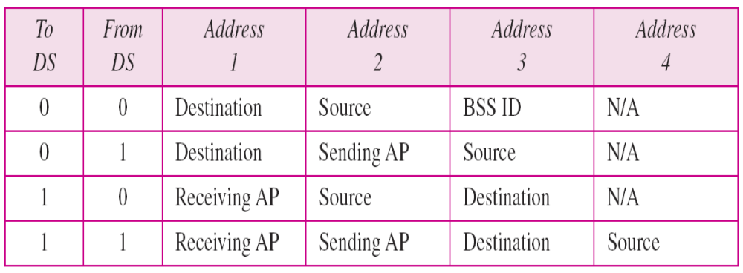
Table 4 Addresses
U. Ghosh

Slide 19
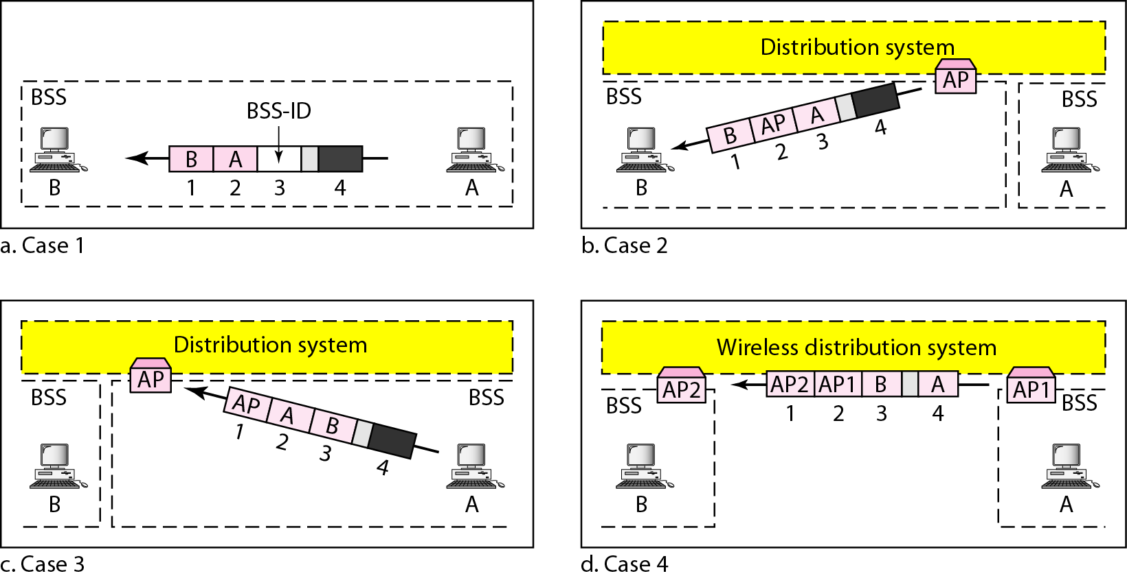
Figure 9 Addressing mechanisms
U. Ghosh

Slide 20
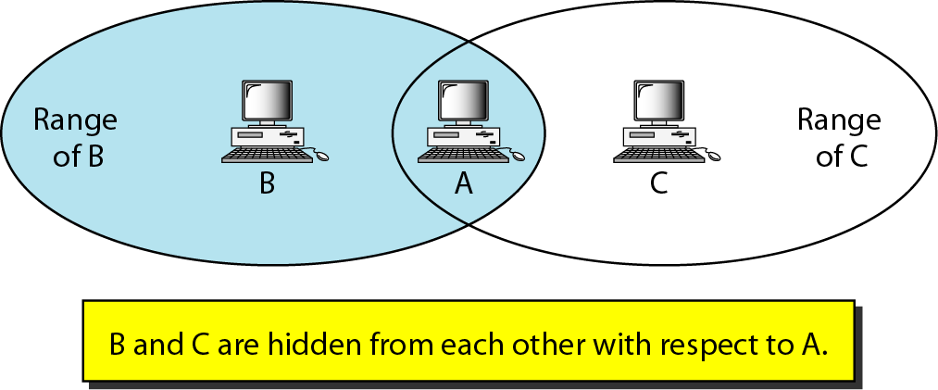
Figure 10 Hidden station problem
U. Ghosh

Slide 21

Note
The CTS frame in CSMA/CA handshake can prevent collision from
a hidden station.
U. Ghosh

Slide 22
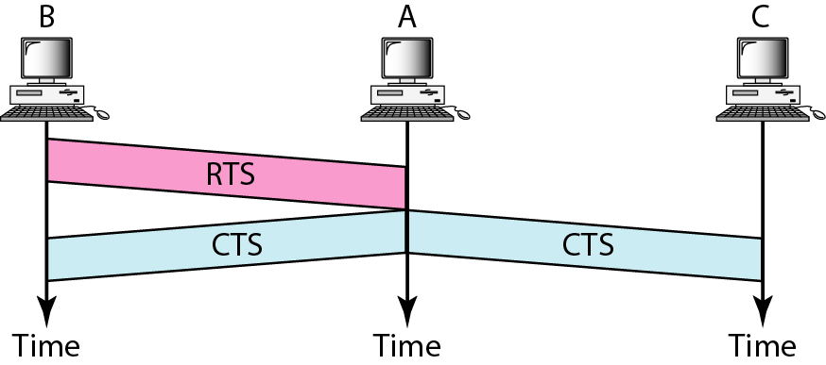
Figure 11 Use of handshaking to prevent hidden station problem
U. Ghosh

Slide 23
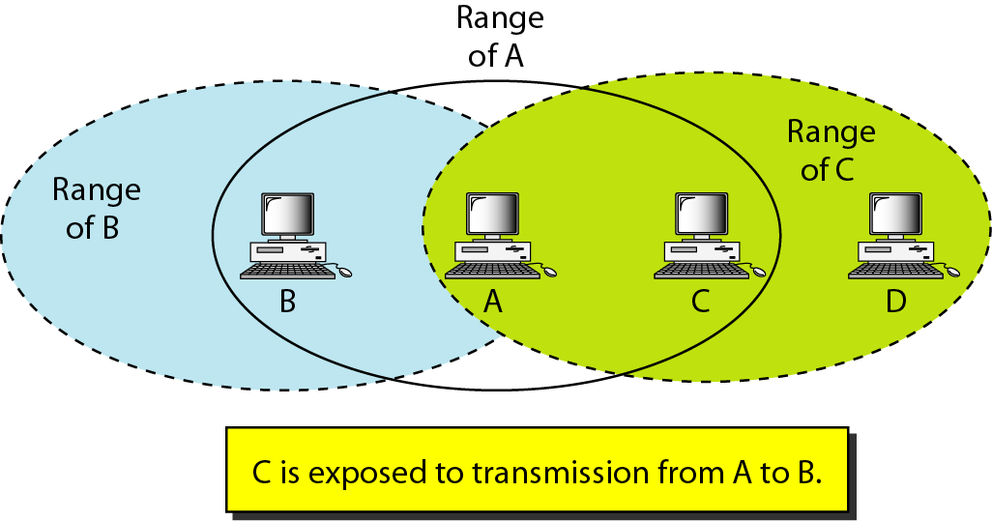
Figure 12 Exposed station problem
U. Ghosh

Slide 24
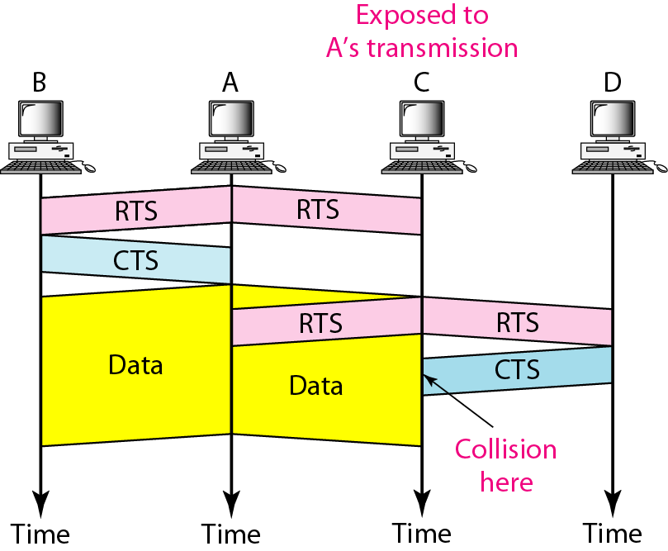
Figure 13 Use of handshaking in exposed station problem
U. Ghosh

Slide 25
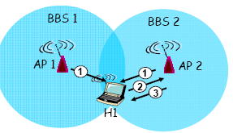
Figure 14 Passive Scanning
Beacon frames sent from AP1 and AP2
2. Association Request frame sent: H1 to selected AP2
3. Association Response frame sent: selected AP2 to H1
U. Ghosh

Slide 26
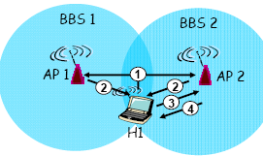
Figure 15 Active Scanning
Probe Request frame broadcast from H1
2. Probes response frame sent from AP1 and AP2
3. Association Request frame sent: H1 to selected AP
4. Association Response frame sent: selected AP to H1
U. Ghosh

Slide 27
Mobile Ad Hoc Networks (MANETs)
Notes:
U. Ghosh

Slide 28
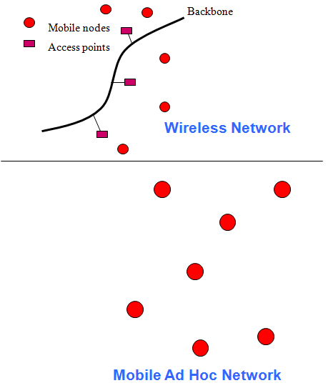
What is MANET?
No Infrastructure.
No Access Point or Base Station.
Every node may act as transmitter, receiver or router.
Nodes can join / leave at any time.
Nodes can communicate only in its radio range.

Slide 29
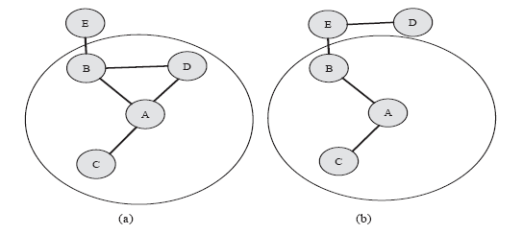
Dynamic Topology
Dynamic Network

Slide 30
Application
Military
  Rapidly deployable battle-site networks
  Sensor fields
  Unmanned aerial vehicles
Disaster Management
  Disaster relief teams that cannot rely on existing infrastructure
Impromptu Communications among groups of people
  Meetings/conferences
  Wearable computing
Automobile Communications

Slide 31
Characteristics
Infrastructureless
High mobility of nodes
No fixed Network Topology
Power Constraints (mostly depend on battery)
Bandwidth Constraints
No fixed Routing Protocol
Limited Physical Security
Resource Constraints

Slide 32



Why Routing?
Why Routing?
Node 2 can communicate with node 1 directly.
Node 2 has to rely on node 1 to communicate with node 3.

Slide 33
Routing Classification
On-Demand (Reactive)
  Ad hoc On-demand Distance Vector (AODV)
  Dynamic Source Routing (DSR)
Table-driven (Proactive)
  Destination-Sequenced Distance-Vector (DSDV)
Hybrid
  Zone Routing Protocol (ZRP)

Slide 34
Reactive Routing
Reactive (on-demand) protocol
Only obtain route information when needed
Advantages
  No overhead from periodic update.
Disadvantages
  High route latency
  Route caching can reduce latency

Slide 35
Proactive Routing
Proactive (table-driven) protocol
More similar to conventional routing
Advantages
  Low route latency
  State information
Disadvantages
  High overhead (periodic table updates)
  Route repair depends on update frequency

Slide 36
Hybrid
Reactive on demand route determination outside routing zone.
Proactive routing within routing zone.
More scalable than proactive.

Slide 37
Ad hoc On-demand Distance Vector (AODV)
Will find routes only as needed by the source node.
Use of Sequence numbers to track accuracy of information.
Only keeps track of next hop for a route instead of the entire route.
Use of periodic HELLO messages to track neighbors.

Slide 38
AODV Messages
Route Request (RREQ)
Route Reply (RREP)
HELLO
Route Error (RERR)

Slide 39
AODV Strategy
Route Discovery
  Route request (RREQ) is flooded
  Route discovery creates temporary reverse routes
  Route reply (RREP) activates forward route
Handling Topology Change
  Link failure generates route error (RERR)
  Destination managed sequence number ensures loop freedom

Slide 40
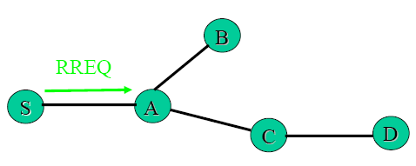
AODV – Route Discovery
  Node S needs a route to D
  Creates a route request(RREQ)
  Enters D’s IP, Seq. No., S’s IP, Seq. No., Hop(0)
  Node S broadcasts to neighbors

Slide 41
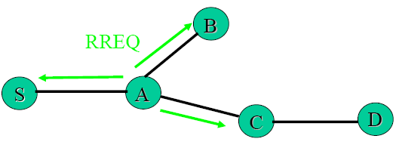
AODV – Route Discovery
  Node A receives RREQ
  Makes a reverse route entry for S
  dest =S, nexthop = S, hop(1)
  It has no routes to D, so it rebroadcasts RREQ

Slide 42
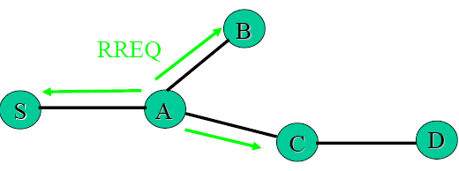
AODV – Route Discovery
    Node C receives RREQ
    Makes a reverse route entry for S
    dest = S, nexthop = A, hop(2)
    It has a route to D

Slide 43
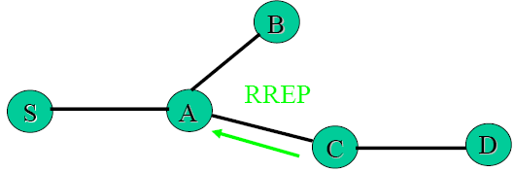
AODV – Route Discovery
C creates a route reply (RREP)
Enters D’s IP, Seq. No., S’s IP, hop(1)
Unicast route reply (RREP) to A

Slide 44
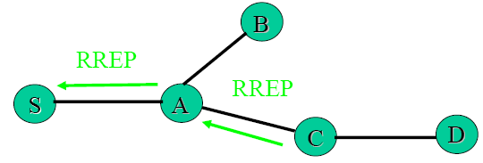
AODV – Route Discovery
Node A receives route reply (RREP)
    Makes a forward route entry to D
dest = D, nexthop = C, hop(2)
Unicast route reply(RREP) to S
Node S receives RREP
  Makes a forward route entry to D
dest = D, nexthop = A, hop(3)

Slide 45
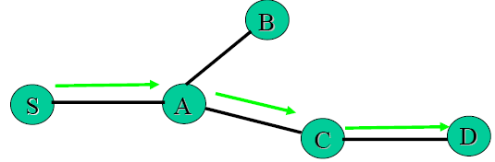
AODV- Data Delivery
    Node S sends data packet on route to D

Slide 46
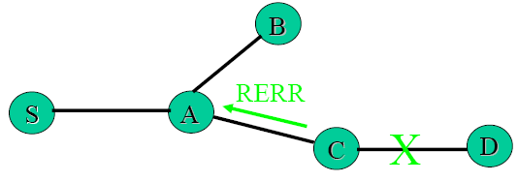
AODV- Route Maintenance
Link between C and D breaks
Node C invalidates route to D in route table
Node C creates Route Error message
  Lists all destinations that are now unreachable
  Sends to upstream neighbors

Slide 47
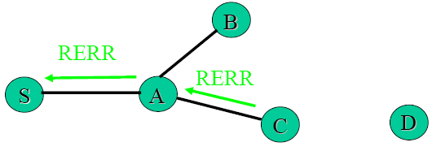
AODV- Route Maintenance
Node A receives RERR
  Checks whether C is its next hop on route to D
  Deletes route to D (makes distance -> infinity)
  Forwards RERR to S

Slide 48
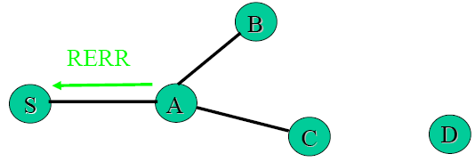
AODV- Route Maintenance
Node S receives RERR
  Checks whether A is its next hop on route to D
  Deletes route to D
  Rediscovers route if still needed

Slide 49
Dynamic Source Routing (DSR)
Reactive or on demand
Maintenance on active route
No periodic activity of any kind – Hello messages in AODV
Use of caches to store routes

Slide 50
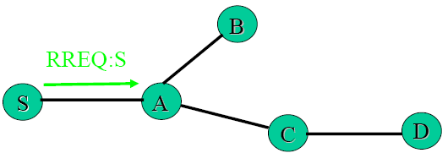
DSR – Route Discovery
Node S needs a route to D
Broadcasts RREQ packet

Slide 51
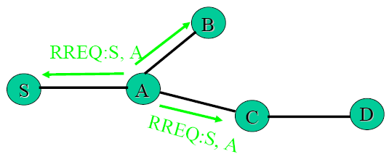
DSR – Route Discovery
Node A receives packet, has no route to D
  Rebroadcasts packet after adding its address to source route

Slide 52
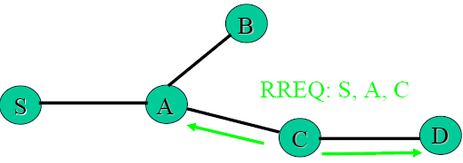
DSR – Route Discovery
Node C receives RREQ, has no route to D
  Rebroadcasts packet after adding its address to source route

Slide 53
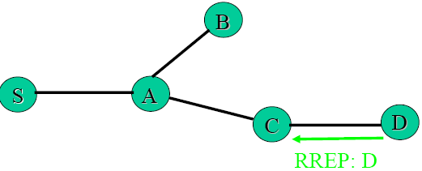
DSR – Route Reply
Node D receives RREQ, unicasts RREP to C
  Puts D in RREP source route

Slide 54
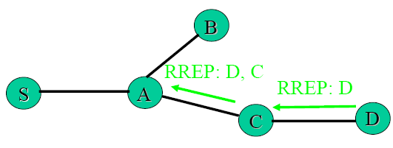
DSR – Route Reply
Node C receives RREP
Adds its address to source route
Unicasts to A

Slide 55
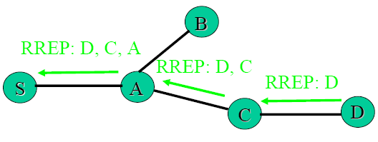
DSR – Route Reply
Node A receives RREP
Adds its address to source route
Unicasts to S

Slide 56
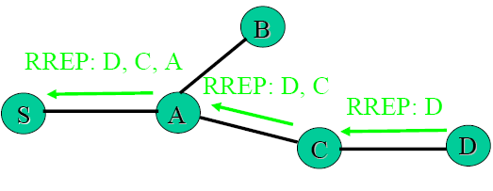
DSR – Route Reply
Node S receives RREP
Uses route for data packet transmissions

Slide 57
Destination-Sequenced Distance-Vector
(DSDV)
DSDV is Proactive (Table Driven)
  Each node maintains routing information for all known destinations
  Routing information must be updated periodically
  Traffic overhead even if there is no change in network topology
  Maintains routes which are never used
Guarantee Loop Freeness
  New Table Entry for Destination Sequence Number

Slide 58
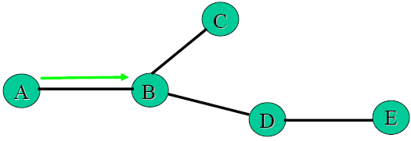
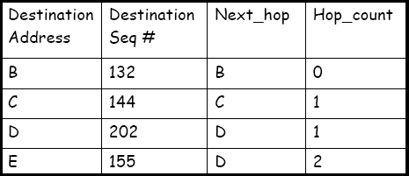
DSDV: Link Additions
B’s routing table
Node A joins network
Node A transmits routing table update <A, 101,0>

Slide 59
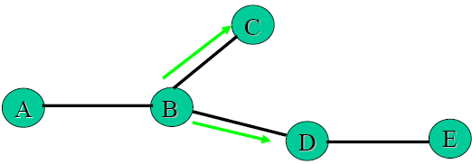
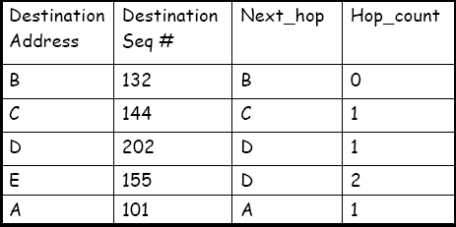
DSDV: Link Additions
B’s routing table
Node B receives transmission, inserts <A, 101, 1> into route table
Node B propagates new route information to neighbors: <A, 101, 1>
Neighbors update their routing tables e.g. nodes C & D, <A, 101, B, 2>, and continue propagation information

Slide 60
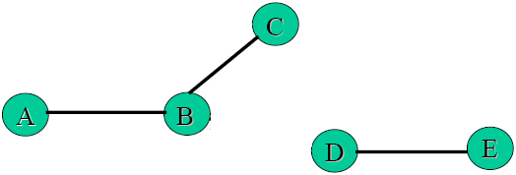
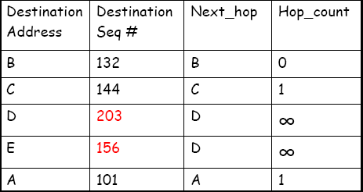
DSDV: Link Breaks
B’s routing table
Link between B and D breaks
Node B notices break
  Updates hopcount for D & E to infinity
  Increments seq# for D & E

Slide 61
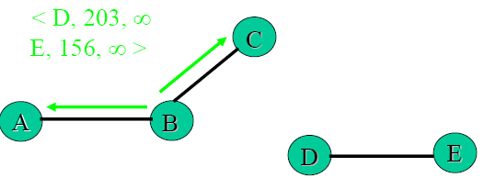
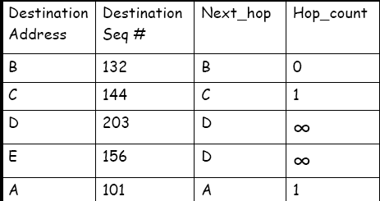
DSDV: Link Breaks
B’s routing table
Node B sends update with new route information

Slide 62
Wireless LANs Testbed

Slide 63
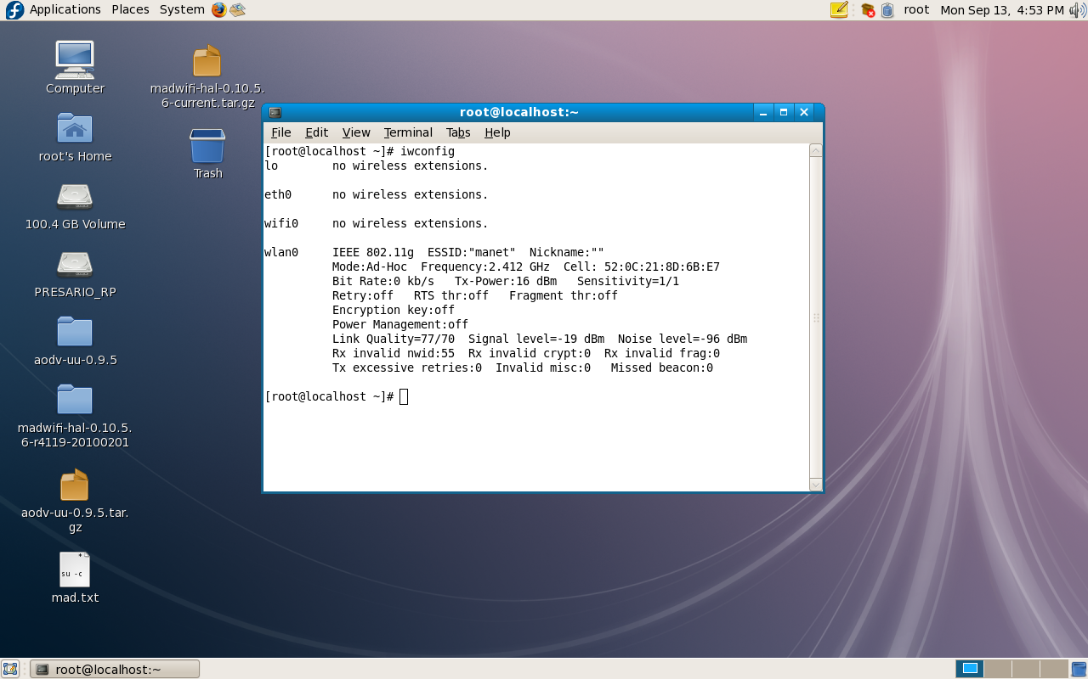
Testbed: iwconfig
U. Ghosh

Slide 64
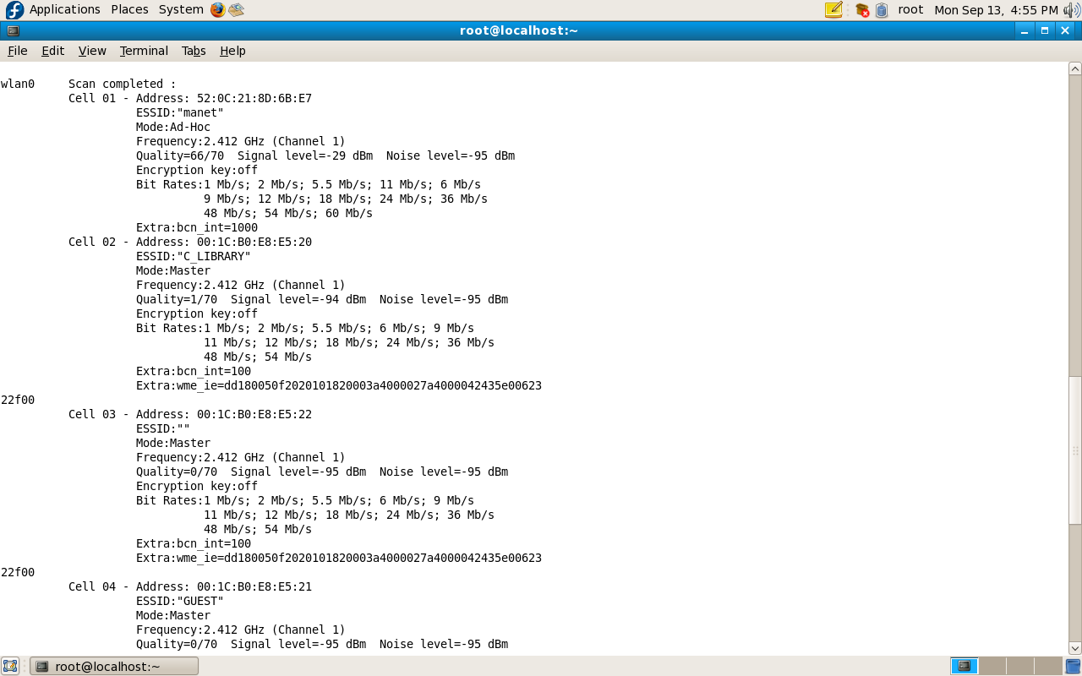
Testbed: iwlist scan
U. Ghosh

Slide 65
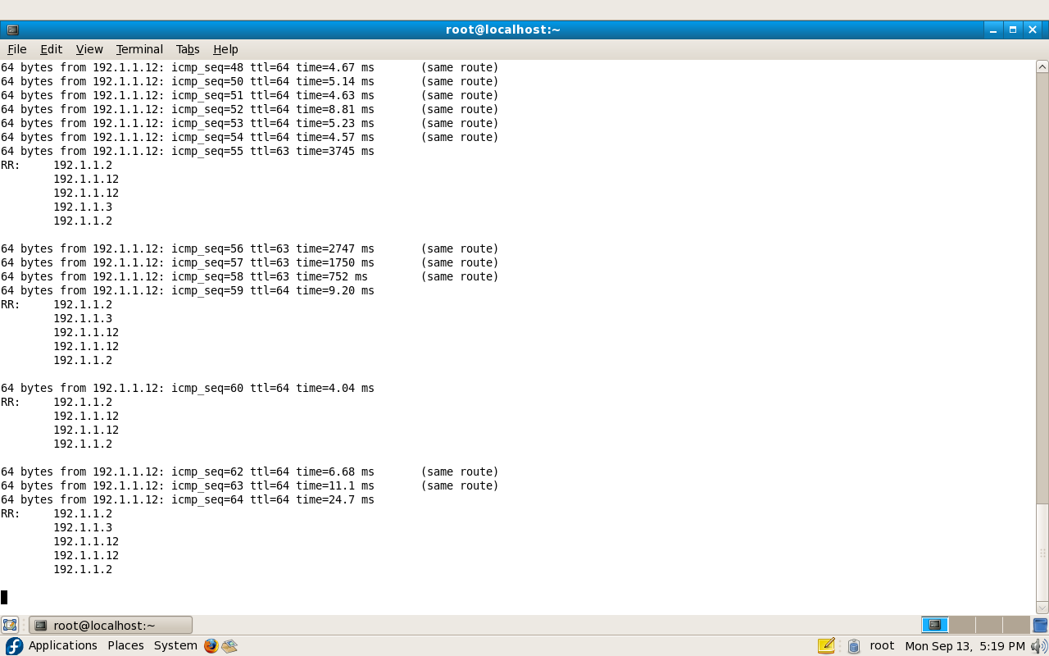
Testbed: Routing with AODV
U. Ghosh

